Slide 1

Courage
Undergraduate
Field Orientation
Quick Overview
Part I
Compassion
Competence

Slide 2

Field Education has a team member on each campus
Check your campus and program – who is your field contact person?

Slide 3
Social Work Discipline
Signature Pedagogy is Field Education

Slide 4




Signature Pedagogy
Represent the central form of instruction and learning in which a profession socializes its students to perform the role of practitioner

Slide 5

Signature Pedagogy
Theoretical & conceptual contributions
“real world” experiences

Slide 6

Signature Pedagogy
Theoretical & conceptual contributions
“real world” experiences
Field Education Does This

Slide 7
Field Education Structure
Expectations ?

Slide 8

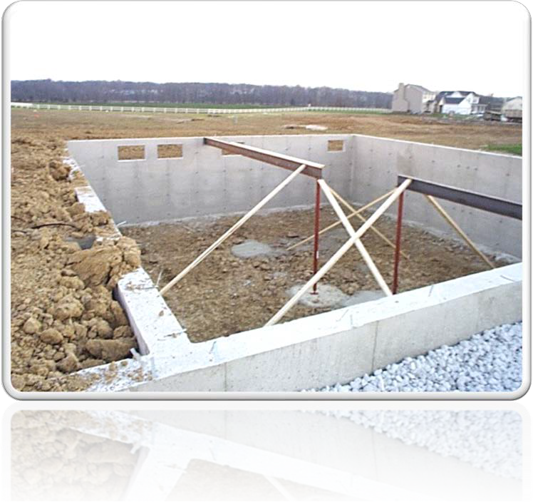
Field Education Structure
Two consecutive semesters
225 hours each semester
Fall & Spring semesters | 15 hours per week
Summer semester
10-week Semester | 22.5 hours per week
13-week Semester | 17.5 hours per week

Slide 9

Field Education Structure
Grade structure |A through F
Fail = repeat field education, if approved |
Field Education IS a course And has assignments
1 minimum hour of weekly supervision with field instructor
At least, 1 Required visit by Faculty Field Liaison per semester

Slide 10
Field Education Structure
Field Placement | Practicum
7750:493 Social Agency I First semester
7750:494 Social Agency II Second semester
3 credits each course|6 credit hours for both semesters

Slide 11
Field Education Structure
Hybrid Seminar Courses| Field Seminar
421- Introduction to Field Experience Seminar- First Semester 422 Field Experience Seminar II- Second Semester
2 credits each course|4 credit hours for both semesters

Slide 12







Field Education Procedure
Designed
Supervised
Coordinated
Evaluated
Engage
Assess
Intervene
Evaluate
CORE Social Work Skills
based on criteria by which students demonstrate achievement of program competencies.
(the ability to do something successfully & efficiently)

Slide 13
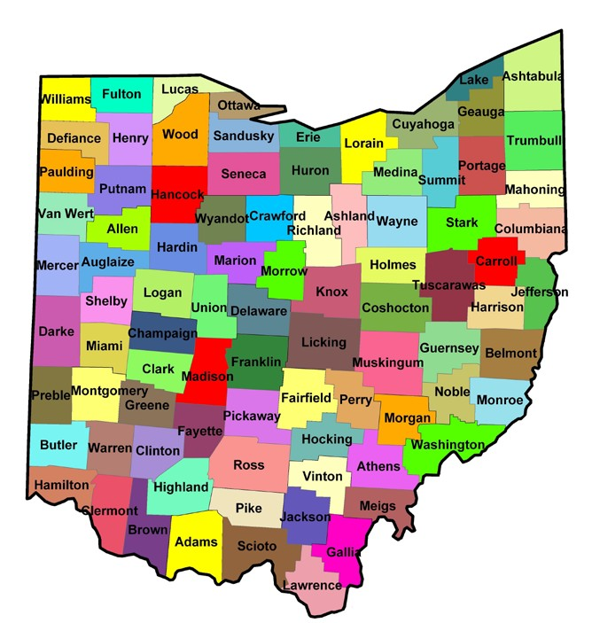




Slide 14





Emerging Generalist
All client systems:
Engage Assess Intervene Evaluate
Client system is individual, family, small group – problem solving\case-based research
Client system is organizations, neighborhoods, community development, administration, policy development, program/service development/implementation, program research

Slide 15
Field Placement at my current workplace-FAPE
Required completion of a proposal
Field Instructor separate person from Employment Supervisor
Separate hours for Field Placement & Employment
Field Instructor = BA|BASW or MSW/MSSA/MSW + 2 years of post- educational experience+ 1 year with employment agency
All Field rules apply

Slide 16
Field Education Terminology
Field a.k.a. Field Placement | Practicum | Internship | Clinicals
Field Coordinator & Field Contacts - University-based
Field Instructor a.k.a. Field Supervisor - Agency based
Field Faculty Liaison =Liaison – University-based

Slide 17

15 Practice Areas- Council on Social Work Education (CSWE)
Target Audience Target Population
Aging/Gerontology
Alcohol, Drug, or Substance Abuse
Child Welfare
Community Planning
Criminal | Juvenile Justice & Corrections
Developmental Disabilities
Domestic Violence| Crisis Intervention
Family Services
Group Services
Health| Community Health
| Hospice
Housing Services
International
Mental Health | Community Health
Occupational Rehabilitation School Social Work
•
•

Slide 18






Specialty Practice Sections- National Association of Social Workers (NASW)
Health
Aging
Alcohol, Tobacco, & Other drugs
Children, Adolescents, & Young Adults
Child Welfare
Mental Health
School Social Work
Social & Economic Justice & Peace
the how to the
what venue

Slide 19
Field Agency Sites
Community Mental Health
Medical Centers |Hospitals | Clinics
Residential Treatment Facilities
Group Homes
Recovery Centers
Battered Women’s Shelters
Animal Sanctuary
Geriatric facilities
Schools
Police Departments |Youth Services
Community Centers
Social Services Agencies
Crisis Intervention
Child Welfare
Worksite
Juvenile Justice
Fire Departments

Slide 20
Securing your field placement

Slide 21


Field Education Procedure- processes
Become familiar with field section of social work website
Review Field Placement -due dates for required documents
Note due date to have a field placement secured prior to start of semester – failure will delay start of field

Slide 22



Field Education Procedure- processes
Locate Agency Roster on website
Peruse agencies reflecting on:
Practice areas; knowledge of self; capture the kind of experience I want to have to demonstrate mastery in competencies
Begin to search via Agency Roster

Slide 23
Pre-Placement Forms and Process
First, complete the Field Education Website Navigational Exercise.
1. Review required forms and documents.
2. Read Field Manual.
3. Read Syllabus for your field course.
4. Locate section on website that contains all pre-placement forms.
5. Complete all forms and submit your field contact person.
6. After completing first set of required forms, search/set up and then complete interviews.

Slide 24
Pre-Placement Forms and Process
First, set of required forms due after complete website activity (should be submitted within two weeks of being assigned field orientation):
1. Undergraduate Field Application
2. FERPA form
3. Field Manual/Code of Ethics form
4. Prior to Interview Choice form
5. Orientation Pre-placement Part 1 Signature page
Second set of required forms are due after student completes interviews and selects agency (should be within six weeks after submission of first set of forms but NO later than first day of semester start field):
6. After Interview Choice form
7. Agency Acceptance form – completed by agency
8. If needed: signed FAPE

Slide 25
Now Time to Find a Placement

Slide 26


Phone 1st & Email 2nd (if no answer to phone call)

Slide 27
Template Email
Good morning/afternoon/evening Ms. Pitts,
My name is Sam Super. I am an undergraduate student at The University of Akron School of Social Work. I begin my field education experience
(identify which semester and year you will begin your field education experience, i.e.. Summer 2017, Fall, 2017, Spring 2018, Fall 2018).
I am interested in scheduling an interview with your or the designated representative for your organization to discuss the possibility of securing a field placement (internship) with your organization. I am required to spend
hours per week in my field placement with a total of per semester (insert applicable information: 15 hours per week /225 hours for fall and spring or 22.5 hours/17.5 hours for 10 weeks in the summer/225 hours.
I look forward to an opportunity to discuss in more depth the alignment of my background and interests with the mission of your organization. I look forward to meeting you and learning more about the role and impact of your organization on our families and communities.
Sincerely,
Sam Super, UA School of Social Work Undergraduate Student

Slide 28


Field Education Procedure- processes
Check organization’s website to ensure familiarity with mission statement and programs offered by the agency you are interested, prior to your scheduled interview.
Check your voice message on your cell and home phone…confirm the professional tone. Would your great-grandmother think the tone, the music, the words were respectable?
Identify your “interview wardrobe”- simplicity is safe. Take a look at yourself in the mirror- minimize any distractions- What could be a potential distraction?

Slide 29

Student Reminders
Be prepared to smile – You are sooooo close to achieving your dream…your goal.
Think about all you have achieved to get to this moment and be prepared to give the interviewer a reason to think they should place you in a toothpaste commercial (smile).

Slide 30

You are unknown…for now!

Slide 31

Learner driven interview questions/ exploratory statements
Interview questions/statements
How can I (the learner) assist your agency in achieving its mission statement?
Please describe specific opportunities I will have as an intern to develop four core areas: Engage, Assess, Intervene, and Evaluate
The School of Social Work requires a minimum of one hour of weekly supervision, is this feasible at this organization?
Please describe your “ideal” Undergraduate social work intern

Slide 32



Social Media
Check all social media accounts and confirm your account reflects the image that would encourage an organization to invest in your growth and development.

Slide 33

It is time- breathe!
Go forth – with Courage
Interact - with Compassion
Interview - with Competence as you demonstrate what you know about the organization, target population, and your school’s field expectations.

Slide 34
Questions?
Ask your field contact person

